Slide 1
Construct a Navigation System using OSMnx API
2023/4/9 |
Notes:
Generate By MotionGo-ChatPPT. Home：motion.yoo-ai.com AIGC 2023/3/26 19:45:38

Slide 2
--------->
Contents
Interactive map
Local location
Location query
Route planning
Deviation detection
Notes:
Generate By MotionGo-ChatPPT. Home：motion.yoo-ai.com AIGC 2023/3/26 19:45:38

Slide 3
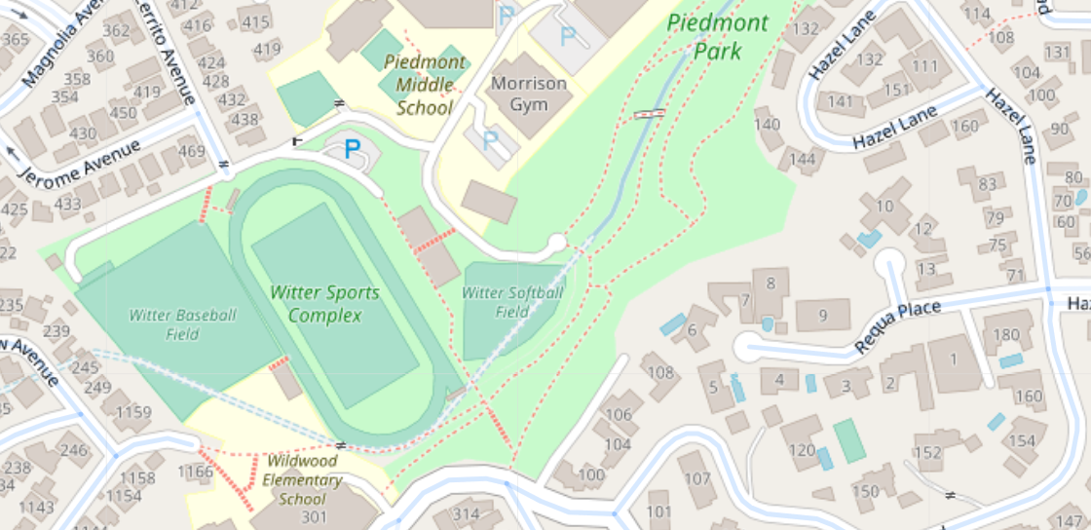
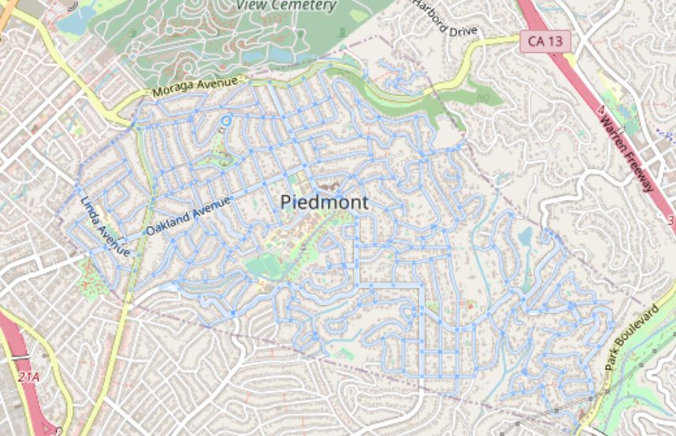
Interactive map
OSMnx already includes Folium package
Piedmont, California, USA

Slide 4
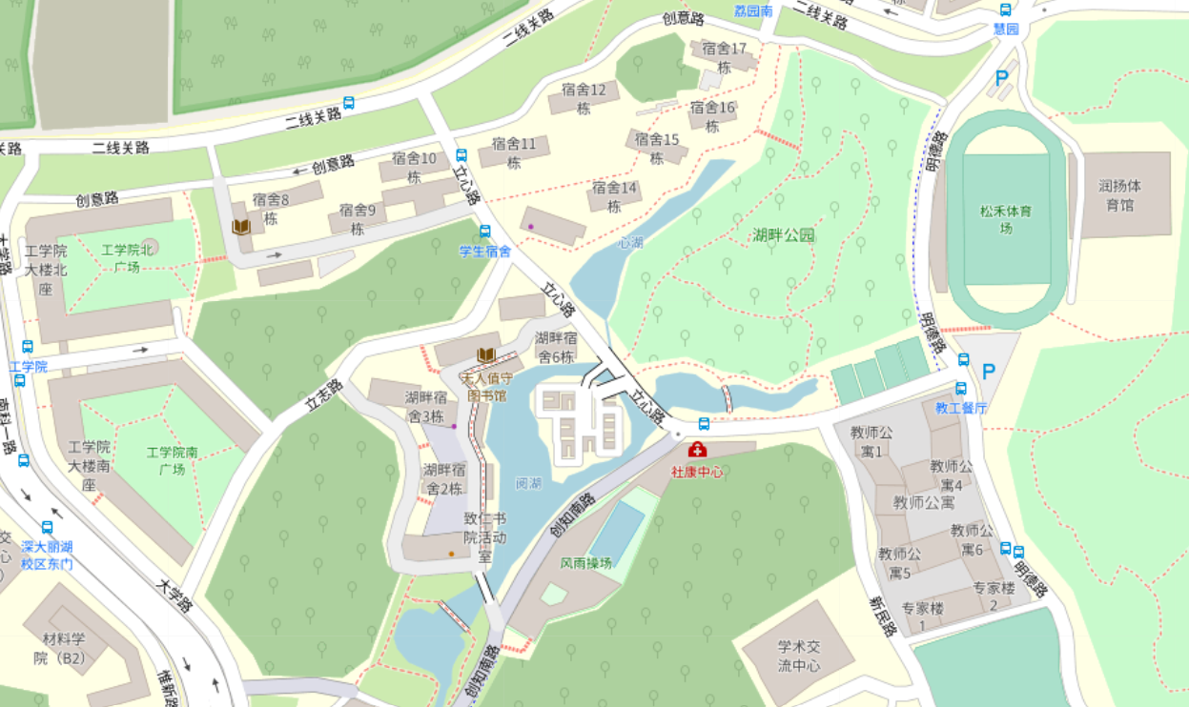
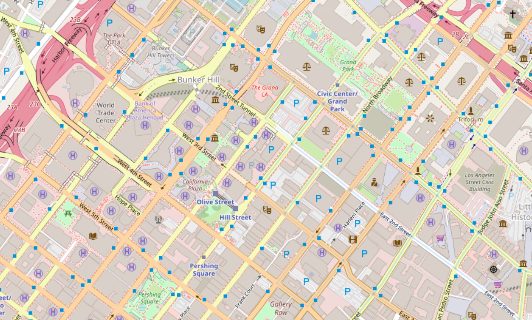
Local location
Based on the association between IP addresses and geographic locations, each device is assigned a unique public IP address when it connects to the Internet. Public IP addresses can be used to locate the general location of devices because Internet service providers (ISPs) often associate IP addresses with geographic locations and maintain a database of such IP addresses.
url = http://httpbin.org/ip geocoder.ip(ip)

Slide 5
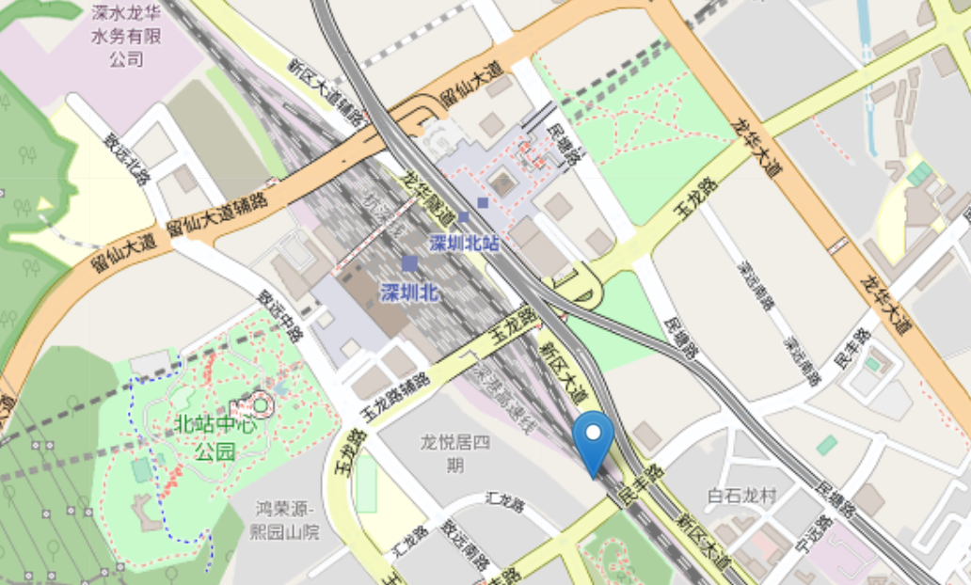
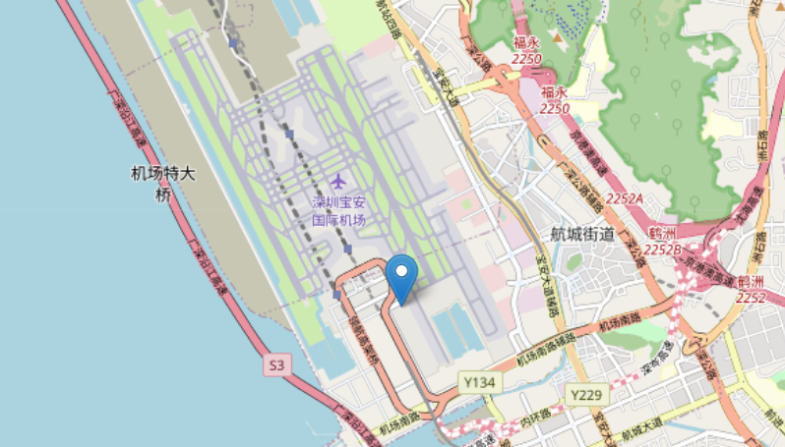
Location query
The user enters keywords (such as name of place, address, POI, etc.) on the front page and sends the keywords to the Amap API server through an HTTP request.
After receiving a user request, the Amap API server will search according to the request parameters and return the search results to the front-end page in JSON format.
url = https://restapi.amap.com/v3/geocode/geo?

Slide 6
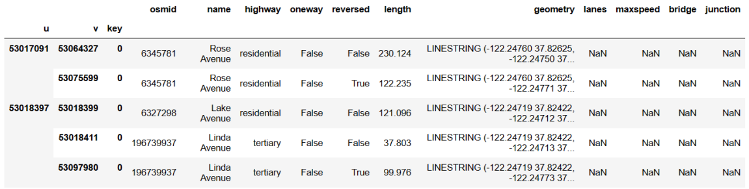
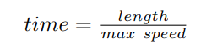
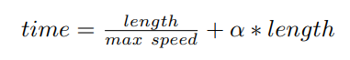
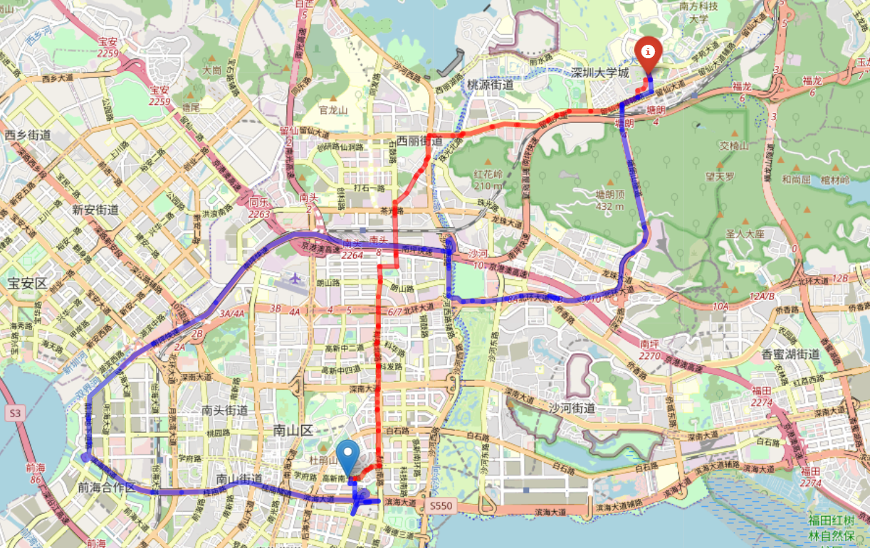
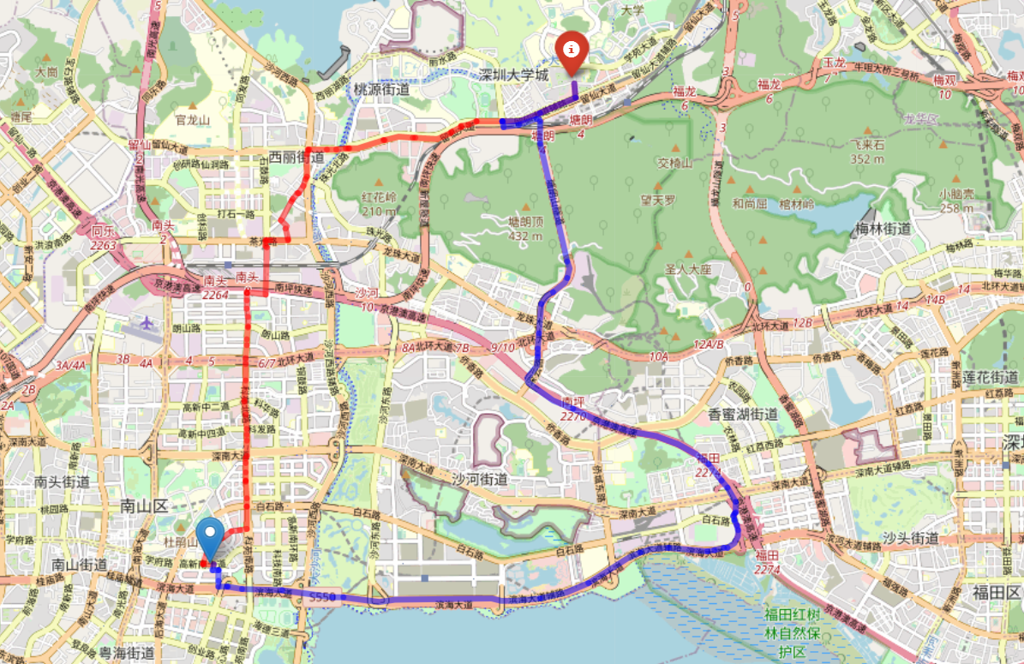
Route planning
the shortest distance \ take the least time
ox.add_edge_speeds & ox.add_edge_travel_times

Slide 7
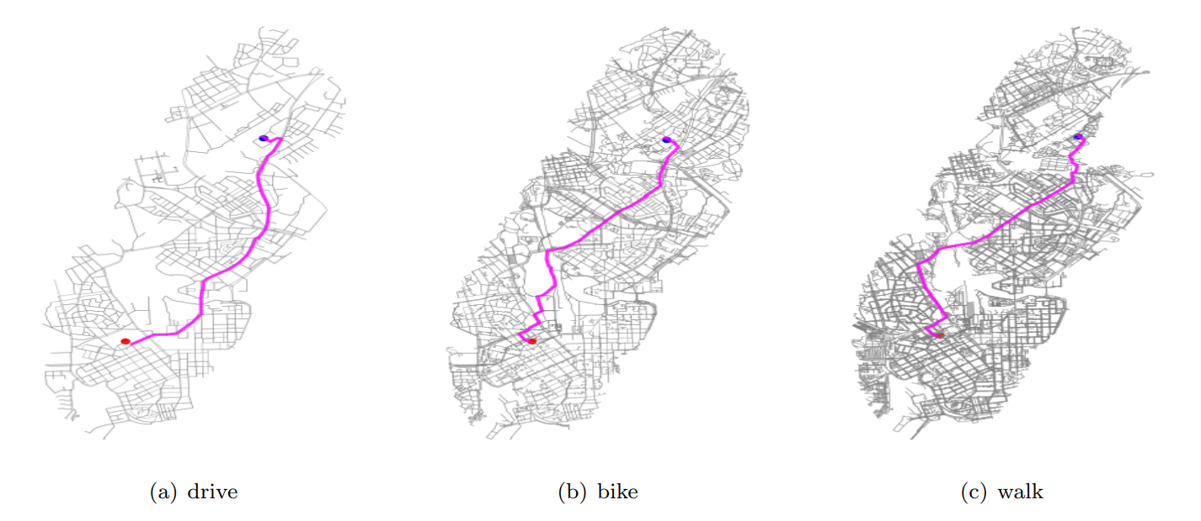
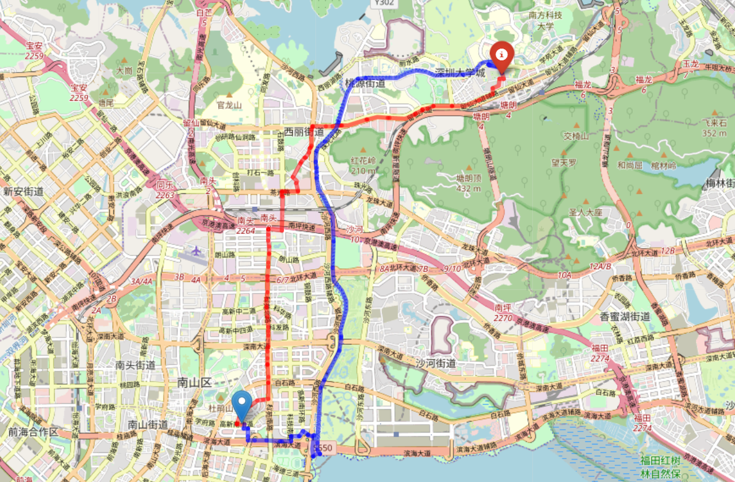
Travel mode
For different travel mode layers, select different layers：
Walk & Bike:

Slide 8
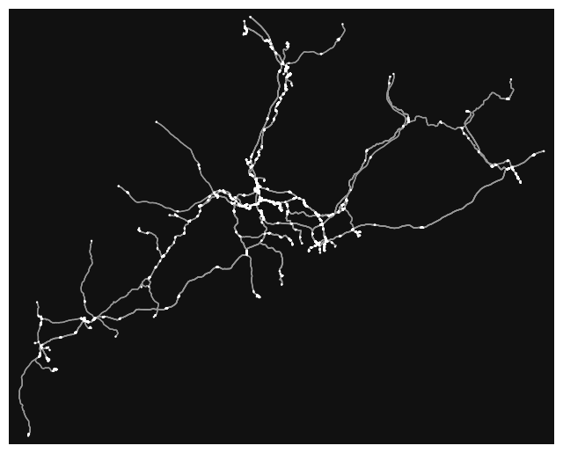
Public transport (railway)
Railway route of Guangdong province:

Slide 9
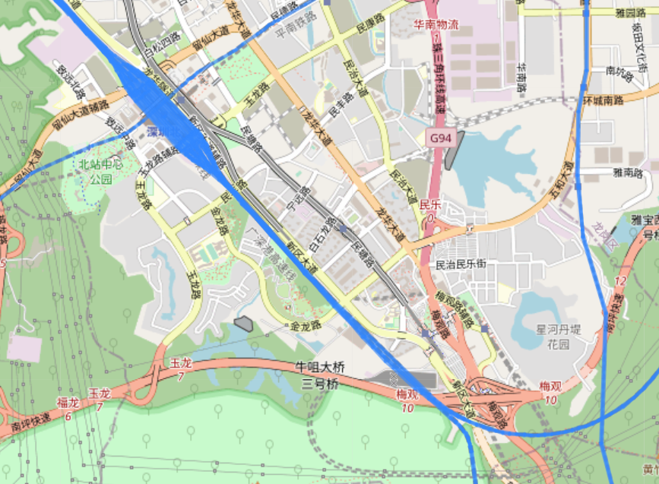
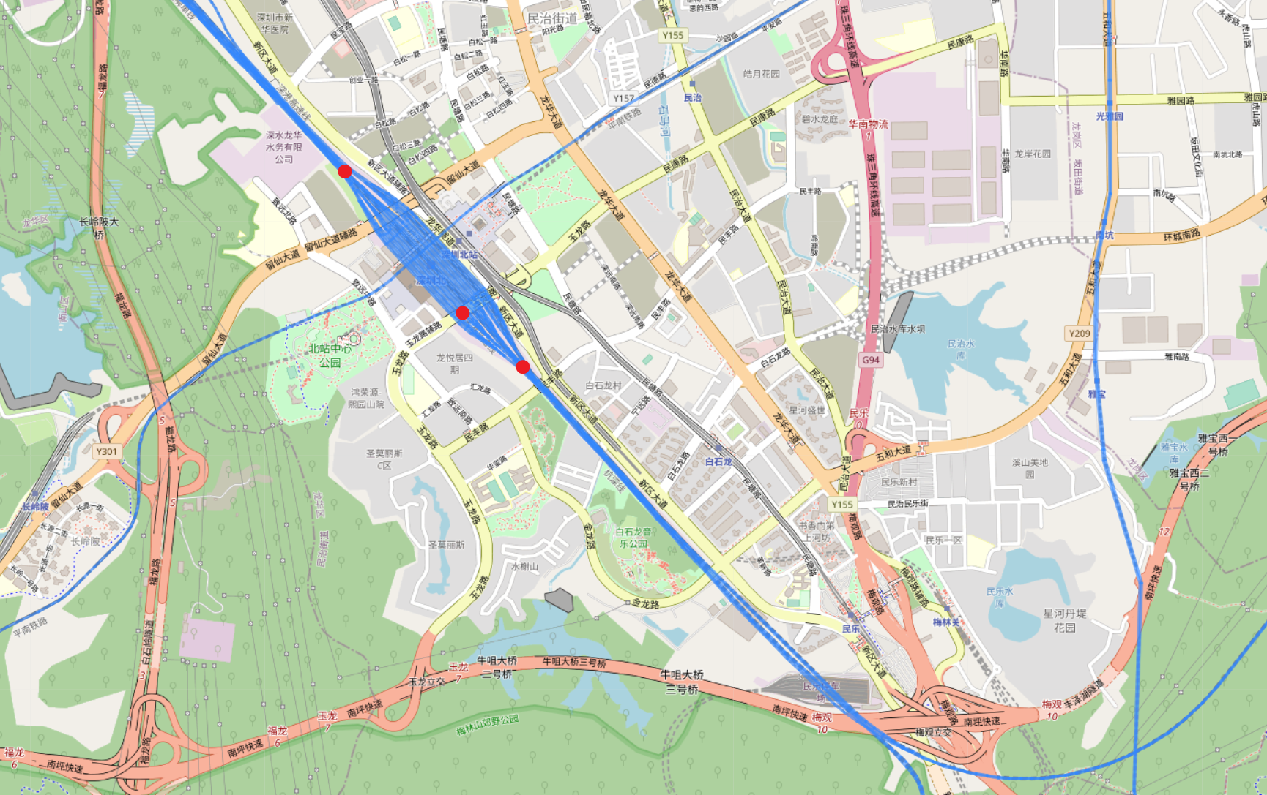
Public transport (railway)
Train stations often have more lines and nodes
Clustering: DBSCAN Kmeans?

Slide 10
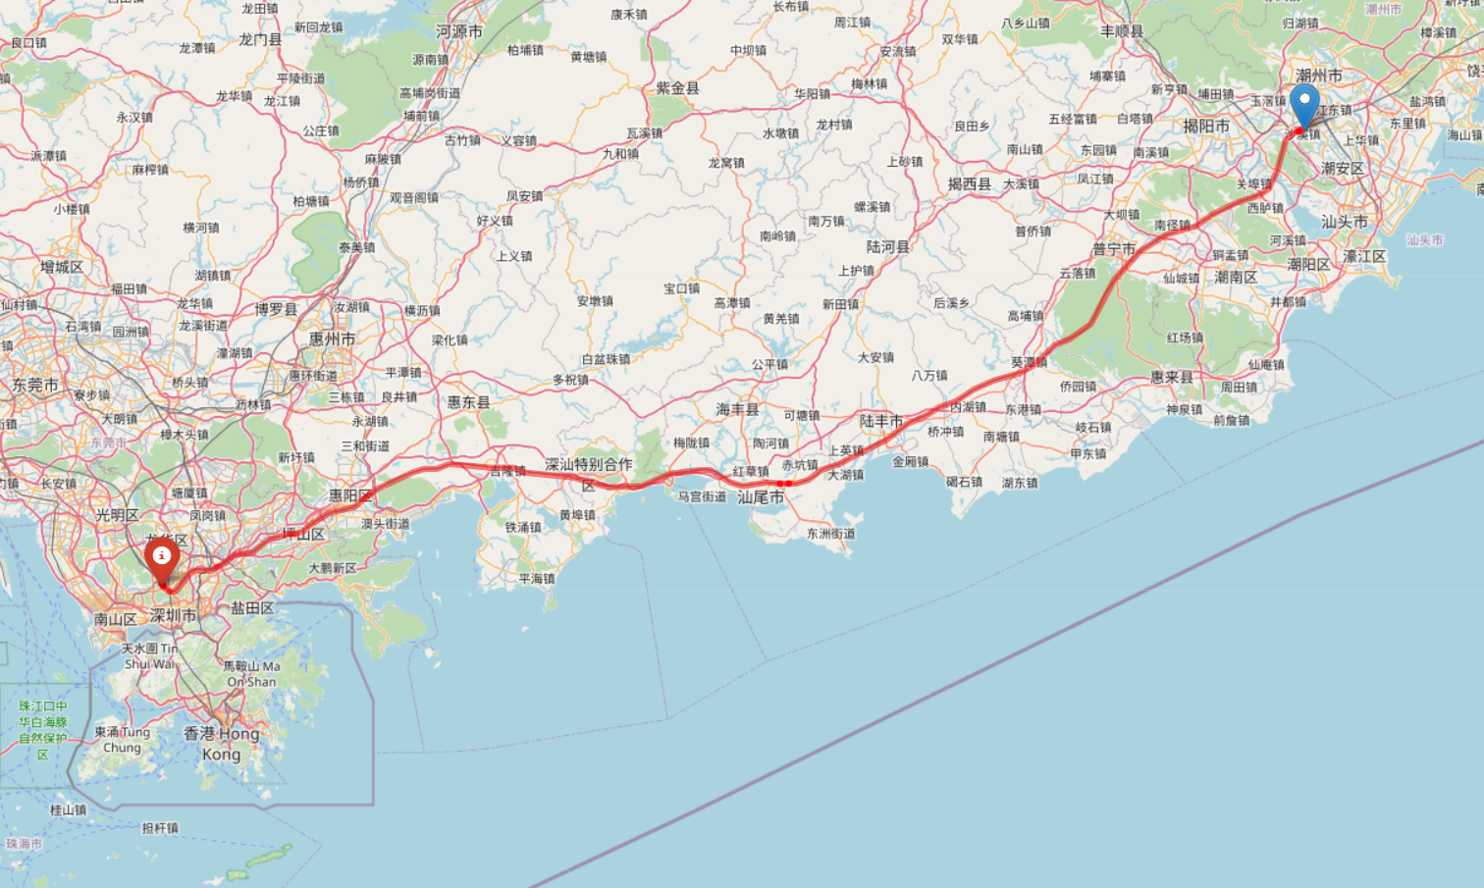
Public transport (railway)

Slide 11
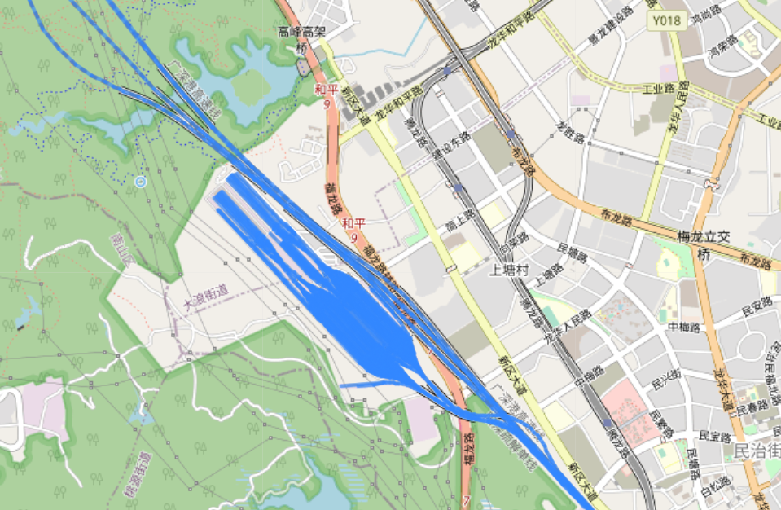
Public transport (railway)
Weekness: some locations that are not railway stations also have dense nodes
Shenzhen North bullet train Station

Slide 12
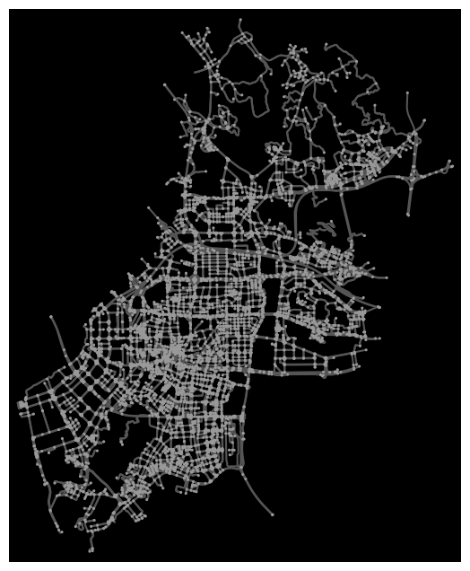
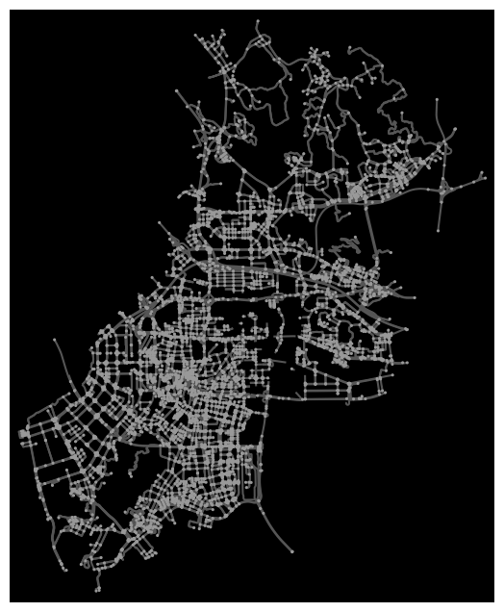
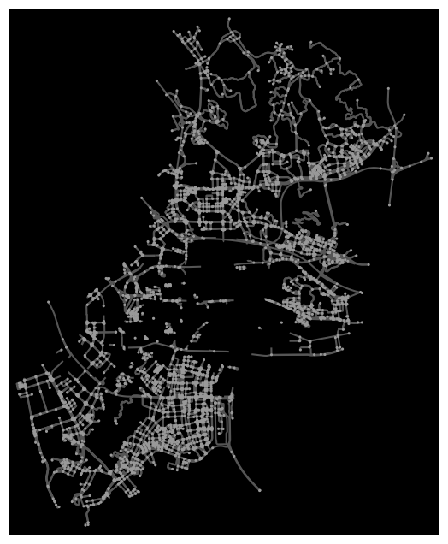
Avoid congestion
There is no real-time traffic flow information
How do you measure congestion?
the more centered the road, the greater the probability of causing congestion
Centrality > 0.03
Centrality > 0.027

Slide 13
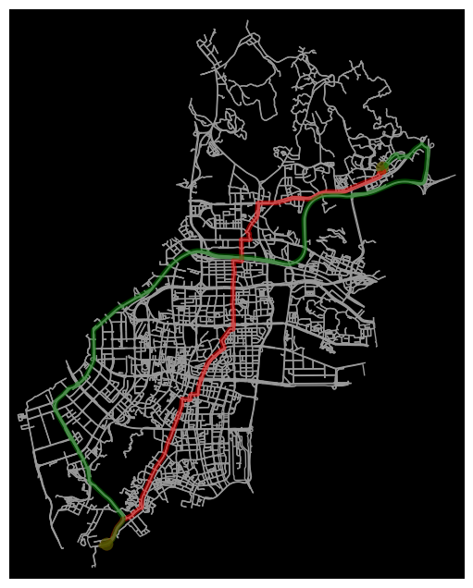
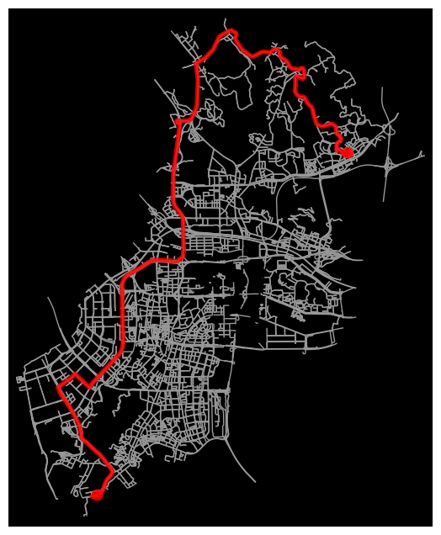
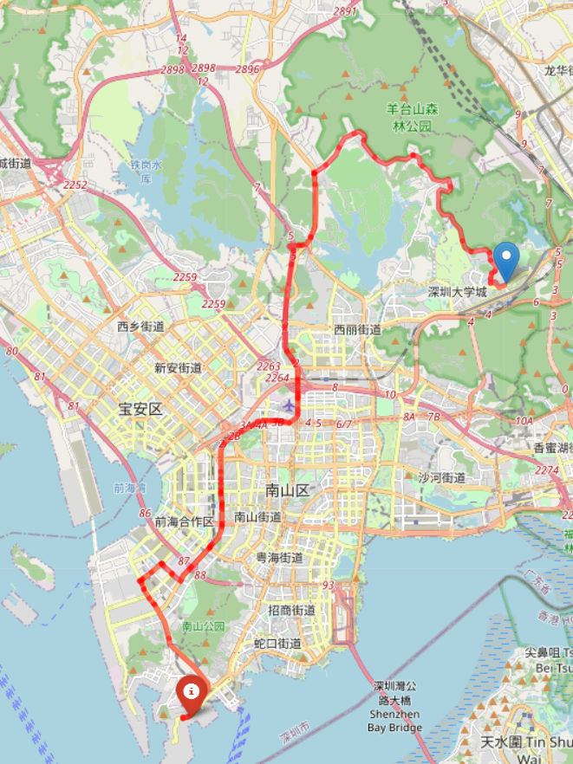
Avoid congestion

Slide 14
Deviation detection
Determine the local location every 5 seconds
Plan a new path to see if it is a subset of the original path
Calculate the shortest distance from the current position to the path
line_segment_point_distance()

Slide 15
Thank You
Thank You
Thank You
Thank You
2023/3/26 |
Notes:
Generate By MotionGo-ChatPPT. Home：motion.yoo-ai.com AIGC 2023/3/26 19:45:38

